Slide 1
Defining the Grid: An Introduction to the
Open Grid Services Architecture
Jem Treadwell, Hewlett-Packard
WoCo9, Prescott AZ
July 18, 2006
OGSA is a trademark of the Global Grid Forum

Slide 2
Defining the Grid: An Introduction to the
Open Grid Services Architecture
Jem Treadwell, Hewlett-Packard
WoCo9, Prescott AZ
July 18, 2006
OGSA is a trademark of the Global Grid Forum

Slide 3
GGF Full Copyright Notice
Copyright (C) Global Grid Forum (2005, 2006). All Rights Reserved.
This document and translations of it may be copied and furnished to others, and derivative works that comment on or otherwise explain it or assist in its implementation may be prepared, copied, published and distributed, in whole or in part, without restriction of any kind, provided that the above copyright notice and this paragraph are included on all such copies and derivative works. However, this document itself may not be modified in any way, such as by removing the copyright notice or references to the GGF or other organizations, except as needed for the purpose of developing Grid Recommendations in which case the procedures for copyrights defined in the GGF Document process must be followed, or as required to translate it into languages other than English.
The limited permissions granted above are perpetual and will not be revoked by the GGF or its successors or assigns.
This document and the information contained herein is provided on an "AS IS" basis and THE GLOBAL GRID FORUM DISCLAIMS ALL WARRANTIES, EXPRESS OR IMPLIED, INCLUDING BUT NOT LIMITED TO ANY WARRANTY THAT THE USE OF THE INFORMATION HEREIN WILL NOT INFRINGE ANY RIGHTS OR ANY IMPLIED WARRANTIES OF MERCHANTABILITY OR FITNESS FOR A PARTICULAR PURPOSE."

Slide 4
Agenda
An Overview of Grid Computing
The Open Grid Services Architecture
A Closer Look at OGSA
The Standards Landscape
The OGSA Working Group
Summary

Slide 5
An Overview of
Grid Computing

Slide 6
A Grid Computing Timeline
US Grid Forum forms at SC ‘98
Grid Forums merge, form GGF
I-Way: SuperComputing ‘95
European & AP Grid Forums
OGSA-WG formed
“Physiology” paper
“Anatomy” paper
OGSA v1.0
…
1995 | ’96 | ’97 | ’98 | ’99 | 2000 | ’01 | ’02 | ’03 | ’04 | ’05 | 2006
  Japan government funds:
  Business Grid project
  NAREGI project
  UK e-Science program starts
DARPA funds Globus Toolkit & Legion
EU funds UNICORE project
US DoE pioneers grids for scientific research
NSF funds National Technology Grid
NASA starts Information Power Grid
  Today:
  Grid solutions are common for HPC
  Grid-based business solutions are becoming common
  Required technologies & standards are evolving
Notes:
Grid began in high-performance technical computing as a way to share widespread computing resources
1994 – 1995 Argonne National Lab & University of Illinois at Chicago formed “I‑WAY” for SuperComputing ’95 (SC95):
Led by Ian Foster
Linked 11 high-speed networks into a “national computing grid”
1997 Globus Toolkit development funded by DARPA*
Then:
US Dept. of Energy pioneered use of grids for scientific research
National Science Foundation funded National Technology Grid
NASA began its Information Power Grid
1998 Grid sessions at SC98 resulted in formation of the US Grid Forum:
Define and promote grid standards and best practices
2000 US Grid Forum merged with European & Asia-Pacific Grid Forums to form the Global Grid Forum (GGF):
Produced many grid standards and specifications
17th GGF conference in May 2006
Participation from major vendors and the grid community
Today:
Grid solutions are common for high-performance computing
Commercial organizations expect grid-based business solutions:
Adoption is in its early stages
Required technologies & standards are evolving
Mainstream adoption expected in the next few years

Slide 7


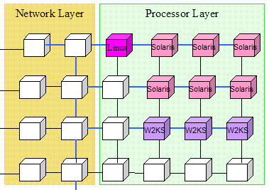
What is a Grid?
A grid is a system consisting of
  Distributed but connected resources and
  Software and/or hardware that provides and manages logically seamless access to those resources to meet desired objectives
Web
server
License
Handheld
Server
Supercomputer
Workstation
Cluster
Data Center
Database
Printer
R2AD

Slide 8
Key Requirements for Grid Middleware

Slide 9
Key Requirements for Grid Middleware
Wide distribution
Fault-tolerant
Secure
Manage complexity

Slide 10
Key Requirements for Grid Middleware
Wide distribution
Fault-tolerant
Secure
Manage complexity
Modular
Composable
Scalable
Extensible

Slide 11
Key Requirements for Grid Middleware
Wide distribution
Fault-tolerant
Secure
Manage complexity
Modular
Composable
Scalable
Extensible
Interoperable
Standards-based
Transparently support legacy components

Slide 12


Three Generations of Grid
  Local “metacomputers“
    Distributed file systems
    Site-wide single sign-on
  "Metacenters" explore inter-organizational integration
  Totally custom-made, top-to-bottom: proofs of concept
1
We are here!
  Utilize software services and communications protocols developed by grid projects:
    Condor, Globus, UNICORE, Legion, etc.
  Need significant customization to deliver complete solution
  Interoperability is still very difficult!
2
  Common interface specifications support interoperability of discrete, independently developed services
  Competition and interoperability among applications, toolkits, and implementations of key services
3
Standardization is key for third-generation grids!
Source: Charlie Catlett

Slide 13
The Open Grid Services
Architecture

Slide 14
The Open Grid Services Architecture
A service-oriented grid architecture (SOA)
  Developed in an open community process
  Resources are first-class entities
  Dynamic creation/destruction of services
Build grids from a few standards-based components
  Replaceable, coarse-grained
  e.g. brokers, job managers, authorization
Built on a Web services infrastructure
Resource virtualization at the core
Customizable
  Support dynamic, domain-specific content
  Within a common standardized framework

Slide 15
A Service-Oriented Grid
Job-Submit Service
Registry Service
Grid middleware services
Brokering Service
Advertise
Notify
CPU Resource
Compute
Service
Data
Service
Application
Service
Printer Service
Virtualized resources

Slide 16
OGSA:
A Closer Look

Slide 17
OGSA Capabilities
OGSA
OGSA “profiles”
Web services foundation

Slide 18
OGSA Capabilities
Execution Management
Job description & submission
Scheduling
Resource provisioning
OGSA
OGSA “profiles”
Web services foundation

Slide 19
OGSA Capabilities
Execution Management
Job description & submission
Scheduling
Resource provisioning
Data Services
Common access facilities
Efficient & reliable transport
Replication services
OGSA
OGSA “profiles”
Web services foundation

Slide 20
OGSA Capabilities
Execution Management
Job description & submission
Scheduling
Resource provisioning
Data Services
Common access facilities
Efficient & reliable transport
Replication services
Resource Management
Discovery
Monitoring
Control
OGSA
OGSA “profiles”
Web services foundation

Slide 21
OGSA Capabilities
Execution Management
Job description & submission
Scheduling
Resource provisioning
Data Services
Common access facilities
Efficient & reliable transport
Replication services
Resource Management
Discovery
Monitoring
Control
OGSA
Self-Management
Self-configuration
Self-optimization
Self-healing
OGSA “profiles”
Web services foundation

Slide 22
OGSA Capabilities
Execution Management
Job description & submission
Scheduling
Resource provisioning
Data Services
Common access facilities
Efficient & reliable transport
Replication services
Resource Management
Discovery
Monitoring
Control
OGSA
Self-Management
Self-configuration
Self-optimization
Self-healing
Information Services
Registry
Notification
Logging/auditing
OGSA “profiles”
Web services foundation

Slide 23
OGSA Capabilities
Execution Management
Job description & submission
Scheduling
Resource provisioning
Data Services
Common access facilities
Efficient & reliable transport
Replication services
Resource Management
Discovery
Monitoring
Control
OGSA
Self-Management
Self-configuration
Self-optimization
Self-healing
Information Services
Registry
Notification
Logging/auditing
Security
Cross-organizational users
Trust nobody
Authorized access only
OGSA “profiles”
Web services foundation

Slide 24
Execution Management
The basic problem
Provision, execute and manage services/resources in a grid
Allow for legacy applications
3. Select from or deploy
required resources
1. Describe the job
CDL
JSDL
Job
Job
2. Submit the job
4. Manage the job

Slide 25
Describing a Job Submission
Job Submission Description Language (JSDL)
  A language for describing the requirements of jobs for submission
  Declarative description
A JSDL document describes the job requirements
  Job identification information
  Application (e.g., executable, arguments)
  Required resources (e.g., CPUs, memory)
  Input/output files
Job
JSDL
IT Infrastructure

Slide 26



Configuration & Deployment
Prepare the infrastructure so that the job can execute
  Provide a right-shaped slot to fit the job
Main parts:
  Configuration Description Language (CDL) provides declarative definition of system configuration
  Deployment service carries out configuration requests to deploy and configure the system
CDL
Prepare
IT Infrastructure

Slide 27
Data Services
The basic problem
Manage, transfer and access distributed data services and resources
Sensor
Relational database
Data stream
Text file
Catalog
Derived data
Notes:
The basic problem
Manage, transfer and access distributed data services and resources
Some use-cases
Replicating data for performance and reliability using high-performance data transfer
Federating distributed data via a common access interface
Managing file-based data and corresponding relational metadata
Issues to address
Many different data “types” and protocols
Multiple possible use-cases, from high-energy physics to business
How can we describe the data?
How can we find the data?
Where is the data needed?

Slide 28
Data Services
The basic problem
Manage, transfer and access distributed data services and resources
Use cases
Manage
Metadata
Data
Move/Copy/Replicate
Data
Data
Common
access
Data
Data
Sensor
Relational database
Data stream
Text file
Catalog
Derived data
Notes:
The basic problem
Manage, transfer and access distributed data services and resources
Some use-cases
Replicating data for performance and reliability using high-performance data transfer
Federating distributed data via a common access interface
Managing file-based data and corresponding relational metadata
Issues to address
Many different data “types” and protocols
Multiple possible use-cases, from high-energy physics to business
How can we describe the data?
How can we find the data?
Where is the data needed?

Slide 29
Data Services
The basic problem
Manage, transfer and access distributed data services and resources
Use cases
Issues
Manage
Metadata
Data
Move/Copy/Replicate
Data
Data
Find
Describe
Common
access
Access
Data
Data
Protocols
Formats
HTTP
Binary
etc.
XML
Binary
etc.
Sensor
Relational database
Data stream
Text file
Catalog
Derived data
Notes:
The basic problem
Manage, transfer and access distributed data services and resources
Some use-cases
Replicating data for performance and reliability using high-performance data transfer
Federating distributed data via a common access interface
Managing file-based data and corresponding relational metadata
Issues to address
Many different data “types” and protocols
Multiple possible use-cases, from high-energy physics to business
How can we describe the data?
How can we find the data?
Where is the data needed?

Slide 30
Basic Data Interfaces
Storage Management
  e.g. Storage Resource Management (SRM)
Data Transfer
  Data Movement Interface Specification (DMIS)
  Protocols (e.g. GridFTP)
Manage
Metadata
Data
Move/Copy/Replicate
Data
Data
Common
access
Data
Data
Data Access
  ByteIO
  Data Access & Integration (DAI)
Replica management
Metadata catalog
Cache management

Slide 31
Resource Management
Provides a framework for resource management functions
  interfaces, services, information models, etc.
Enables integrated discovery, monitoring, control, etc.
Domain-specific capabilities
Application-
specific
OGSA
High-level
management
services
(GGF)
Execution
Management
services
Data
services
Security
services
WSDM, WS-Management
Access to
manageability
(OASIS, DMTF)
WSRF/WSN, WS-Transfer/Eventing
Resources
Information
models (DMTF,
SNIA, etc.)
Notes:
SNIA: Storage Networking Industry Association

Slide 32
Self-Management
Self-configuration: Automatically adapt to changes in the environment:
  e.g. Deploy/undeploy resources as load changes
Self-optimization: Automatically tune system to best meet user or business needs
  Uses service-level agreements (SLAs)
Self-healing: Automatically detect & correct problems
  Avoid disruption to operations
  Component failures
  Security violations
  etc.
SLA
Policy
Policy
Self-
Management
Monitoring
Action
Analysis
Policy
Policy
Policy
Projection

Slide 33
Information Services
Provide management and access facilities for information about applications and resources in the grid environment
Information
Services
Registry
Service
discovery
Load
balancing
Problem
determination
Asynchronous
notification
Producers
Consumers
Execution
management
Retrieval
Accounting
Reliable
Secure
Efficient
Resource
reservation
Logger
Application
monitoring

Slide 34
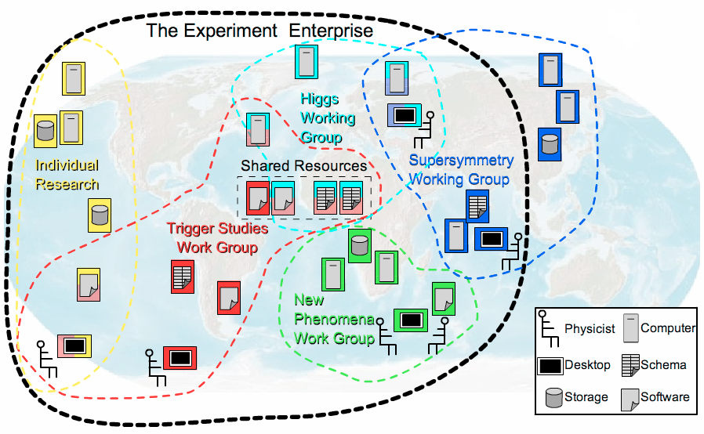
Security Services
Security policies must be enforced across all OGSA services
Locally managed
  Support domain-specific security infrastructure
Services:
  Authentication
  Identity mapping
  Credential conversion
  Authorization
  Audit & secure logging
  Privacy
WS-Security
PKI
certificate
OGSA
security profiles
WS-Addressing

Slide 35
OGSA Profiles
The normative definition of OGSA
  Styled on WS-I profiles to promote interoperability
  Define specific usage patterns
    e.g. execution management
  Basis for claims of conformance
    “My scheduler conforms to the OGSA Execution Management Profile…”
Include specifications developed by GGF and by other bodies
  Issue: How mature and widely adopted?
  OGSA Profile Definition document provides guidelines
OGSA WSRF Basic Profile
Execution Mgmt Profile
OGSA Basic Security Profile – Core
HPC Profile
Data Profile
OGSA Basic Security Profile – Secure Channel
Others…
In the pipeline
Early stages
In the future

Slide 36
OGSA and the
Standards Landscape

Slide 37
Specifications Landscape: April 2006
Warning: Volatile data!
SYSTEMS
MANAGEMENT
GRID
COMPUTING
UTILITY
COMPUTING
Use Cases &
Applications
Distributed query processing
Data Centre
Collaboration
Persistent Archive
ASP
Multi Media
VO Management
OGSA Self Mgmt
OGSA-EMS
WS-DAI
Information
WSDM
Discovery
GGF-UR
WS-BaseNotification
Naming
Core Services
Privacy
Trust
GFD-C.16
WSRF-RP
WSRF-RL
Data Model
Web Services
Foundation
WSRF-RAP
WS-Security
SAML/XACML
X.509
WS-Addressing
HTTP(S)/SOAP
WSDL
CIM/JSIM
Data Transport
Hole
Gap
Evolving
Standard

Slide 38




Related Standards Bodies
GGF (Global Grid Forum)/Open Grid Forum
  Overall architecture for grid computing
  OGSA, CDDLM, WS-Agreement, …
OASIS (Organization for the Advancement of Structured Information Standards)
  Middleware/Web services focused
  WSRF, WS-Notification, WSDM, WS-Security…
DMTF (Distributed Management Task Force)
  Management and Information models (CIM)
  Server management
  WS-CIM
W3C (WWW Consortium)
  WS-Addressing
Not a complete list!
Logos are trademarks or service marks of their respective owners.

Slide 39
Making It Happen:
The OGSA Working Group

Slide 40

The OGSA Working Group
History
  Established September 2002
  Declared GGF’s “flagship architecture” March 2004
Getting it done
  Over 300 mailing-list subscribers
  Twice-weekly teleconferences
  Regular face-to-face meetings
  Collaboration with other working groups and standards organizations
Contributors
  Industry
  Government
  Academia

Slide 41

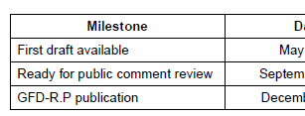
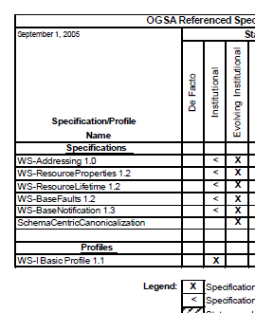
The OGSA Roadmap
Defines OGSA as:
  An architectural process
  A set of specifications & profiles
  OGSA software
For each OGSA-related document:
  Schedule
  Dependencies
Publication:
  v1.0 published September ’05 (GFD.53)
  Next version in progress

Slide 42
Published OGSA Documents
2004
2005
2006
✓
Use Cases (GFD-I.29)
Base document
✓
Architecture V1.0 (GFD-I.30)
✓
Glossary V1.0 (GFD-I.44)
✓
Resource Management
(GFD-I.45)
Roadmap (GFD-I.53)
✓
Guideline
Profile Definition (GFD-I.59)
✓
Service description
Profile
Specification
JSDL (GFD-R-P.56)
✓

Slide 43
OGSA Schedule
2005
2006
Architecture V1.5
Glossary V1.5
Base document
Roadmap V1.1
Guideline
Modeling guideline
Service description
EMS arch scenarios
Data architecture
WSRF Basic Profile
Basic Security Profiles
Profile
HPC Profile
ByteIO
Basic Execution Service
Specification
Container info-model
WS-Naming
Public comment start
GFD publication

Slide 44

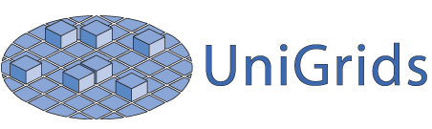







OGSA-Based Open-Source Grids
Numerous grid projects are implementing
OGSA components

Slide 45
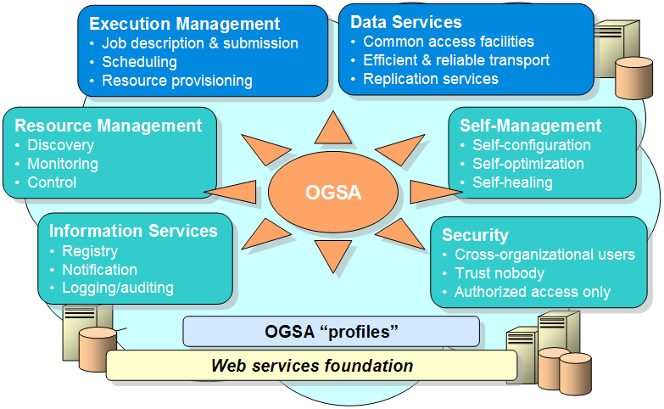
Summary
Building robust, distributed, applications is a challenge
  Significant issues need to be solved
  Grids address the challenges

Slide 46
Summary
Building robust, distributed, applications is a challenge
  Significant issues need to be solved
  Grids address the challenges
Interoperability is a key requirement
  Standards are the key to interoperability

Slide 47
Summary
Building robust, distributed, applications is a challenge
  Significant issues need to be solved
  Grids address the challenges
Interoperability is a key requirement
  Standards are the key to interoperability
OGSA is defining a set of core services
  Designed to work together…
  …but with implementation flexibility

Slide 48
Summary
Building robust, distributed, applications is a challenge
  Significant issues need to be solved
  Grids address the challenges
Interoperability is a key requirement
  Standards are the key to interoperability
OGSA is defining a set of core services
  Designed to work together…
  …but with implementation flexibility
The services currently being defined are the first few of many that will be needed

Slide 49

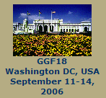


For More Information…
http://www.ggf.org
http://forge.gridforum.org/projects/ogsa-wg
http://www.presentationselect.com/HPinvent/archive.asp?eventid=1188

